Slide 1




Username
Password
Forgot password?
Buy Groceries Easily With Us
Login
Not registered yet? Sign-up
or
Get Started

Slide 2






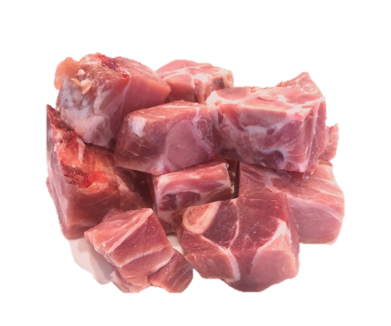
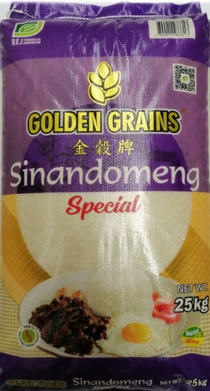
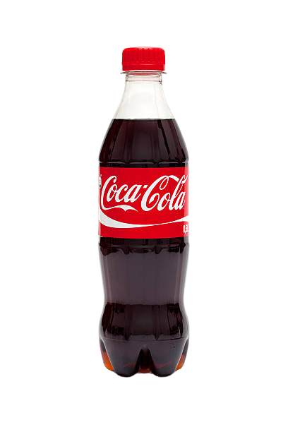






Categories
See All
Beverages
Personal Care
First name
Last name
Email
SHOP YOUR DAILY NEEDS
Username
Password
Popular Products
See All
Already have an account?
Sign-up
Fresh Pork
Golden Grains
Sinandomeng Rice 25kg
Coca-cola

Slide 3




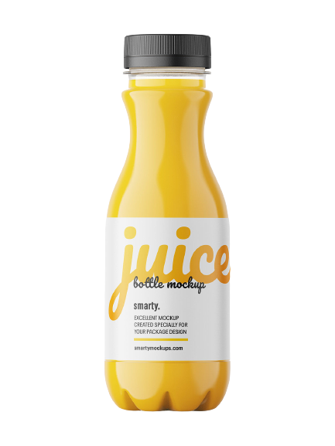









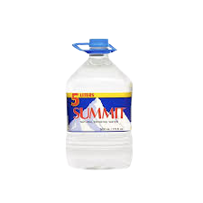
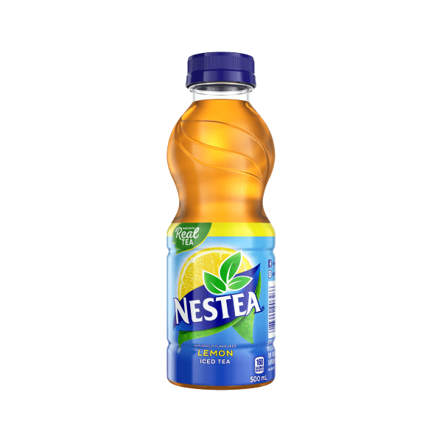
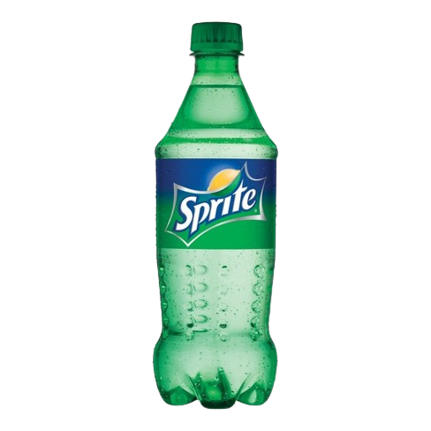










Beverages
Categories
Beverages
Personal Care
Canned good and Condiments
Produce
$₱$30
Add to cart
$₱2$0
Add to cart
$$₱15$$
Add to cart
Ratings
Ratings
Ratings
Cleaners
Rice
Meat
Snack
$₱$19
Add to cart
$₱$15
Add to cart
$$₱40$$
Add to cart
Ratings
Ratings
Ratings

Slide 4
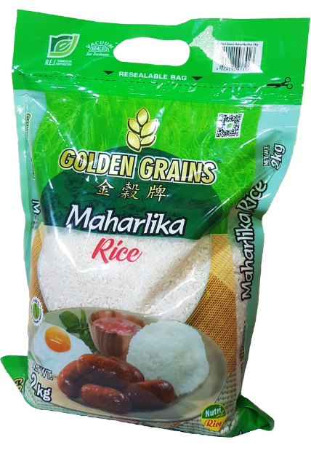
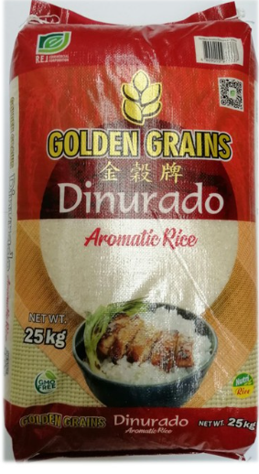
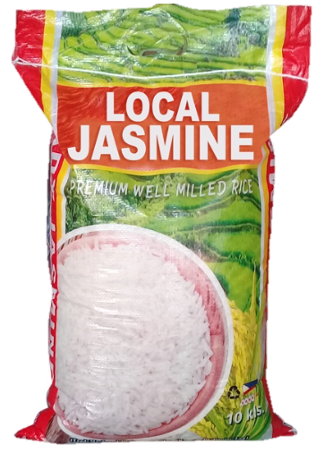
Recent Search
Rice
Diapers
Shampoo
Fresh Pork
₱315
Add to cart
Quantity:
- 1kg +
JASMINE RICE
5 kilograms per pack
Golden Grains Dinurado
Rice 25kg
Buy Now
₱297
₱1,400
Product Description:
Fresh Pork
Packaging/Size (Approximate Weight Only): 1 KG
Price: 1 KG
Delivery period: Within an our!
This product is frozen.
450 sold
505 sold
Product Ratings
Feedback:
Golden Grains
Sinandomeng Rice 25kg
Kitchen Marks Local
Jasmine 10 kilos
₱ 1,265
2,092 sold
₱ 590
2,096 sold

Slide 5


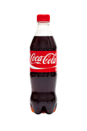



Cart
Check Out
Shipping Address
JASMINE RICE
5 kg per pack
1
First name
Last name
Address
₱297
Contact Number
Coca- Cola
2
Payment Method
Cash on Delivery
₱15
Item Subtotal ₱327
Shipping Subtotal ₱30
Total Payment ₱357
TOTAL: ₱327
Check Out
Check Out

Slide 6
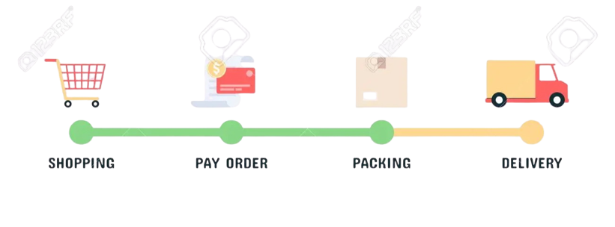



Order
Order Details
All
Pending
Processing
Delivered
QTY
JASMINE RICE
5 kg per pack
1
₱297
Pending
Coca- Cola
2
₱30
Processing
Fresh Pork
1
₱315
Buy Again

Slide 7

Hi, Welcome back!
Users
32,234
+ 2.12%
Total users in Barangay Sampaguita
Username
Password
Forgot password?
Login
Total Sales
Total Orders
₱ 43,434
This month
₱ 43,434
This month
Admin
Total Purchases
Total growth
₱ 43,434
This month
₱ 43,434
This month
. . .
Beverages
Personal
care
Rice
Snack

